Slide 1
Capstone Project Global Terrorism Analysis

Slide 2
CONTENT
1. GLOBAL TERRORISM ANALYSIS
A) ANALYSIS OF TERRORISM ALL OVER THE WORLD
i) How terrorist activities have increased/decreased from 1970-2017.
ii) Top countries that have suffered most against the terrorism.
iii) Terrorism in sub-continents.
iv) Most Active Terrorist groups.
v) No. of deaths due to terrorism.
vi) Weapons mostly used by the Terrorists.
B) ANALYSIS OF TERRORISM IN INDIA
i) How terrorist activities have increased/decreased from 1970-2017.
ii) Cities in India which were mostly targeted by Terrorist Groups.
iii) Main Targets of Terrorists.
iv) Weapons mostly used by the Terrorists.
v) No. Deaths in India due to Terrorist activities.
vi) Terrorist groups which were mostly involved in the attacks .

Slide 3
part I

Slide 4
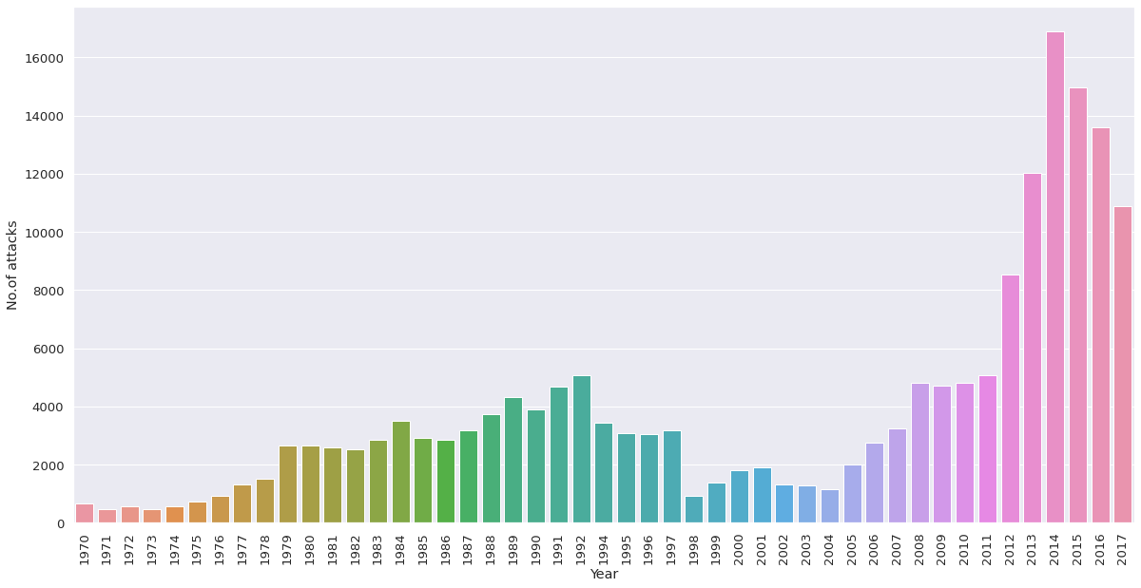
No. of attacks over the years ● There has been rise and dip in the rate of attacks from 1970 to 2017 but this rise has increased from the year 2012 and maxed in year 2013.

Slide 5
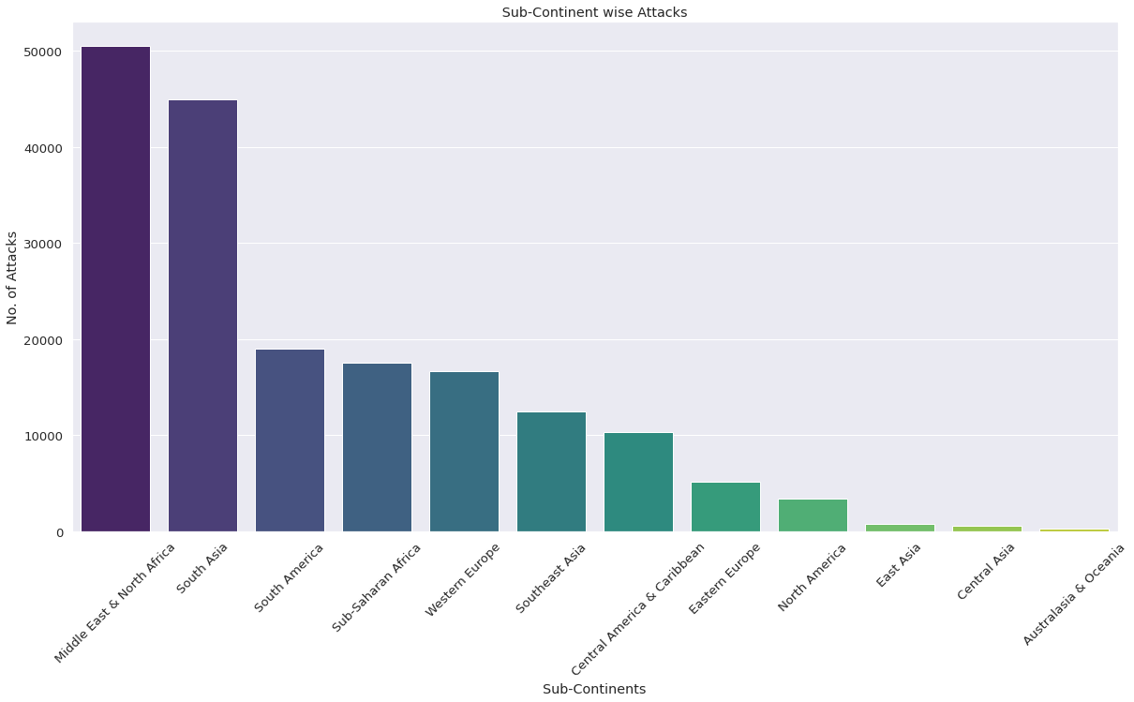
Terrorist attacks on sub-continents ● Middle East & North Africa , South Asia followed by south America and sub-Saharan desert tops the list of sub-continents which has faced most number of terror attacks.

Slide 6
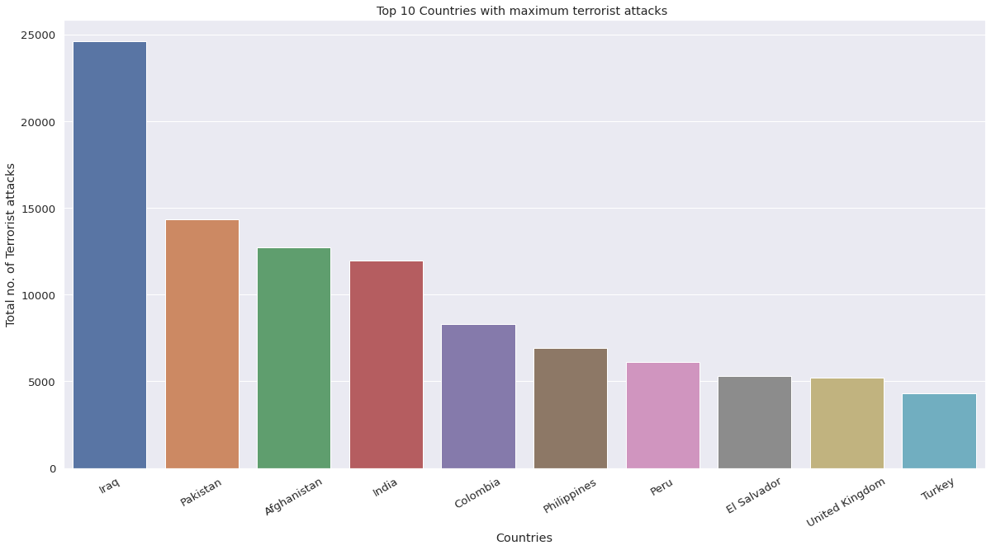
Top countries which have ● Iraq tops the list of 195 countries in facing most no. of terrorist attacks followed by Pakistan, Afghanistan , India , Colombia , Philippines , Peru , El Salvador , United Kingdom and Turkey.

Slide 7
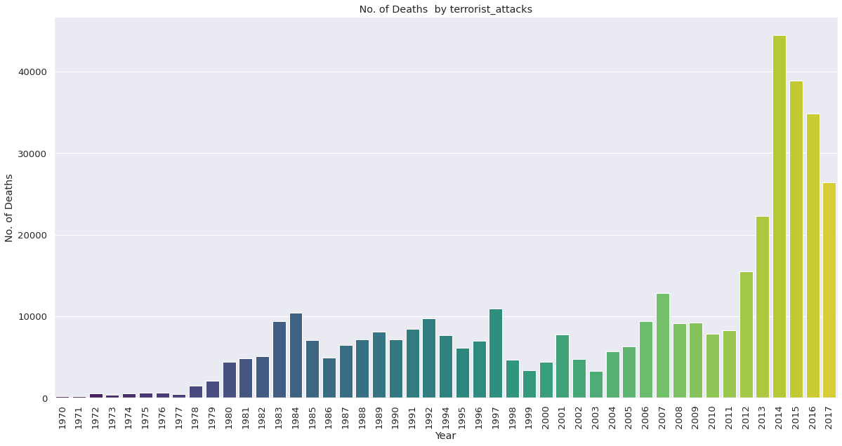
No. of Deaths due to Terrorist activities ● There has been fluctuations in the no. of deaths since 1970 but in the past 5 years the numbers have significantly increased.

Slide 8
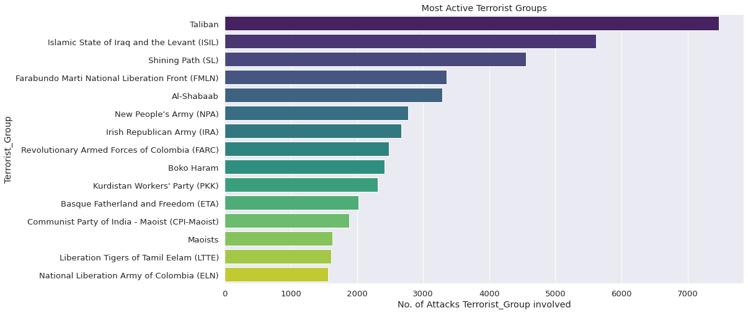
Most active terrorist groups

Slide 9
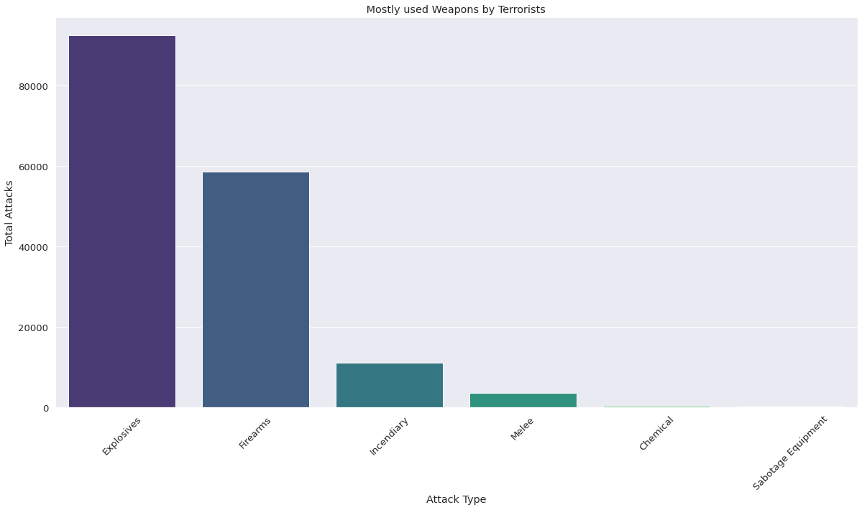
weapons mostly used by terrorist

Slide 10
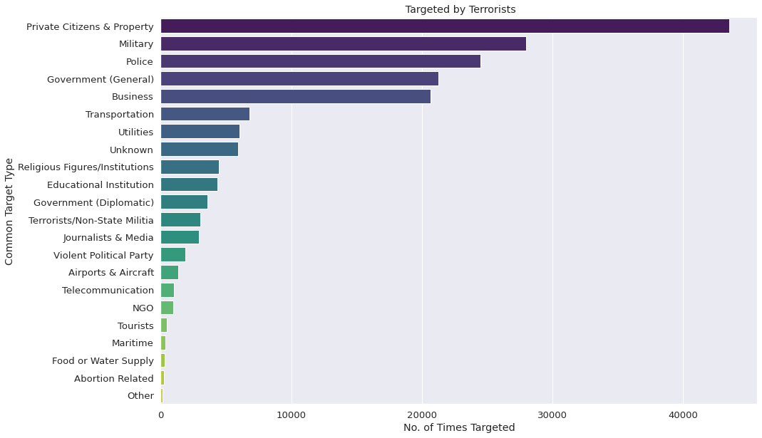
● Targeted mostly by terrorists.

Slide 11
Part ii

Slide 12
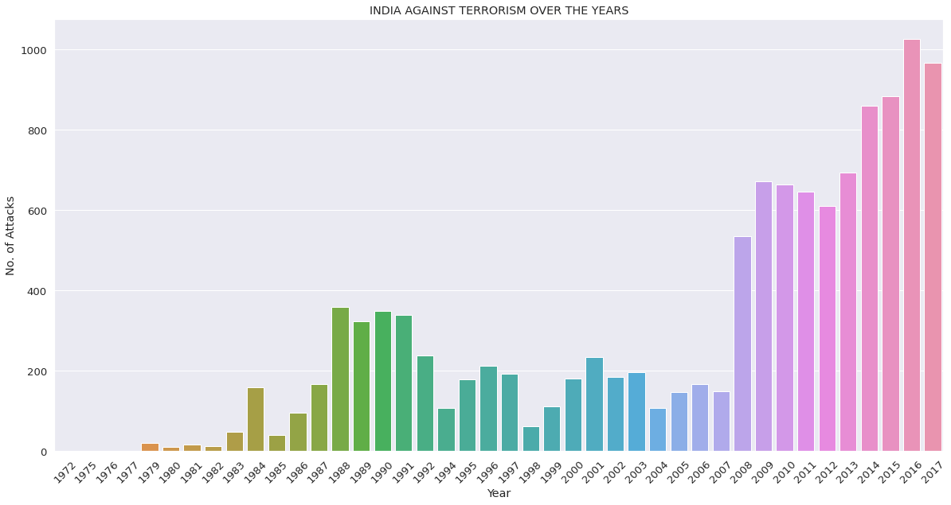
No. of Terrorist attacks in India over the year ● In the past 10 years the no. of terrorist attacks have significantly increased in comparison to the no. of attacks between 1970 and 2007.

Slide 13
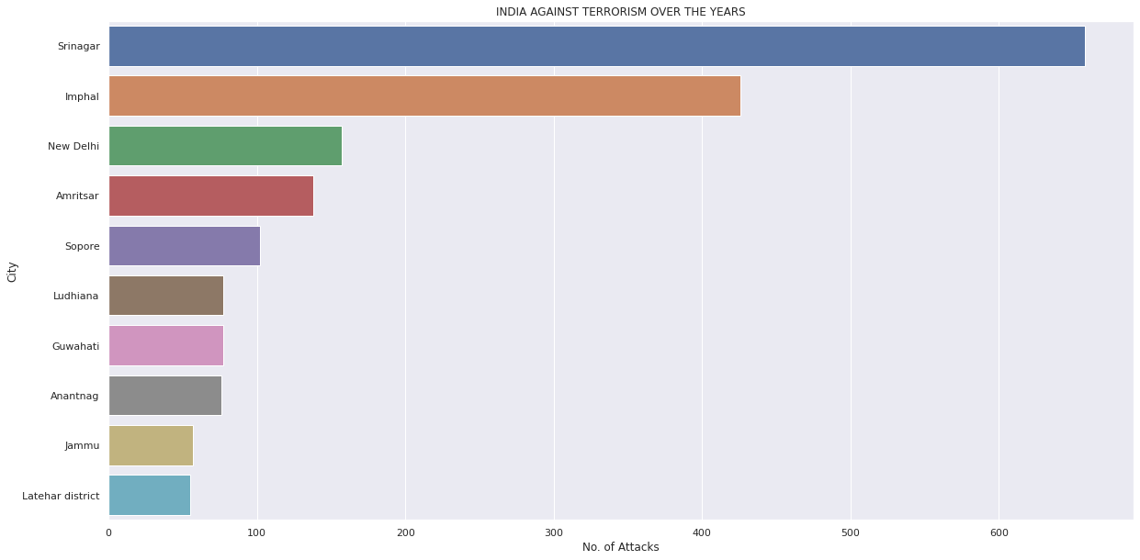
Most affected cities in India by terrorism. ● Srinagar is the city affected most by terrorism in India followed by Imphal and New Delhi.

Slide 14
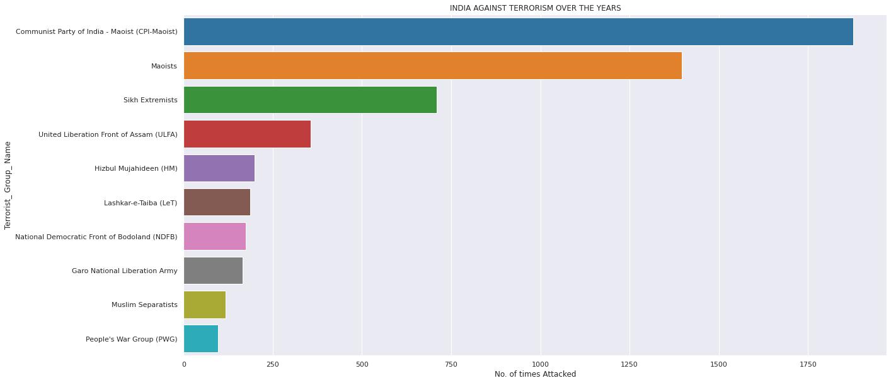
Terrorist groups which are involved in most no. of terrorist attacks in India.

Slide 15
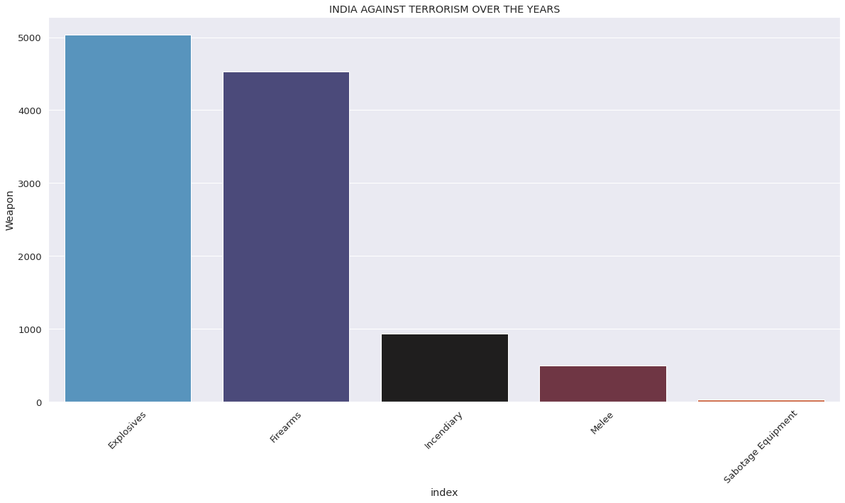
Weapons mostly used by terrorist groups . ● Explosives are mainly used for the attacks followed by firearms in comparison to the other weapons.

Slide 16
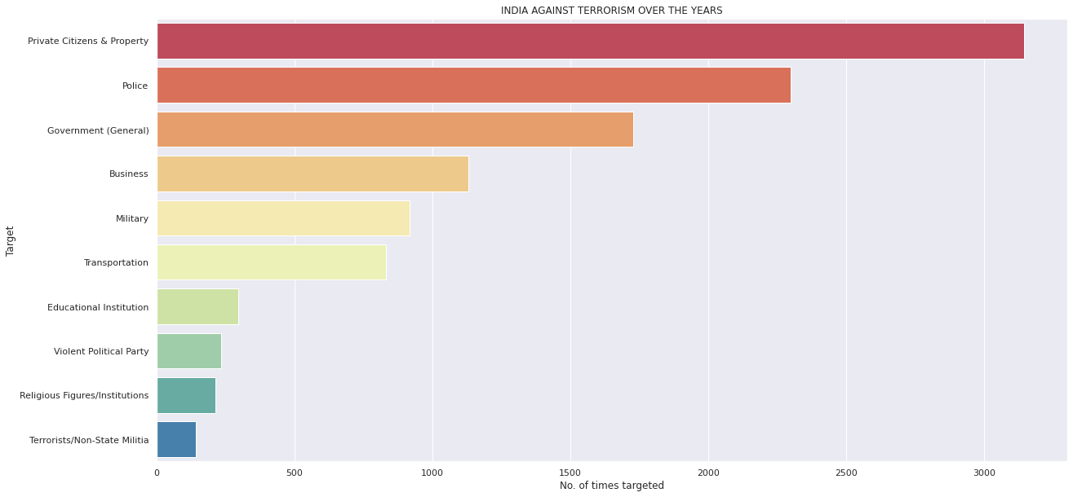
Mainly targeted by Terrorist groups.

Slide 17
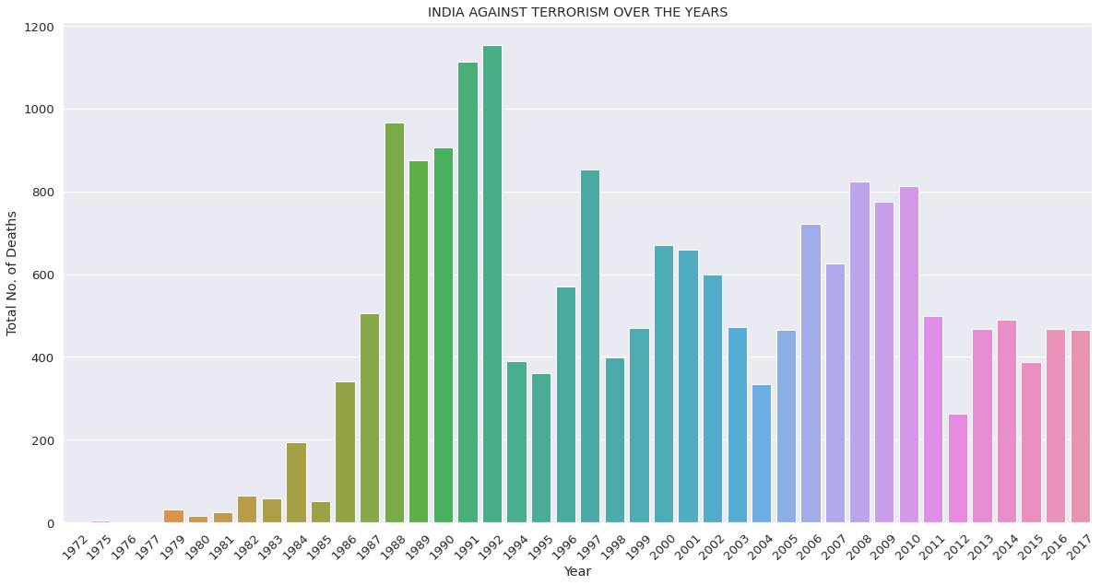
● India have been hugely affected by the terrorist attacks over the past 30 years. ● Maximum no. of deaths were caused in the year of 1992 and relatively equal in the year of 1991.

Slide 18
conclusion
part i
a) In the past 5 years the no. of terrorist attacks have increased causing a lots of death.
b) If we look closely then we can see that countries in Middle East ,North Africa and
South Asia has been the prime target for terrorist in the recent time. Those countries
are Iraq, Pakistan, Afghanistan , India and Philippines.
c) ‘Taliban’ the Terrorist group is involved in the most no. of attacks which mostly uses
‘Explosives’ for the attacks then firearms.
part ii
a) In the past 10 years no. of terrorist attacks in the countries has increased
significantly.
b) Srinagar and Imphal tops the list of cities which have faced terrorist attacks.
c) CPI Maoists , Maoists are the active groups in India involved in maximum no. of
attacks.
d) Mostly private citizen and private property has been targeted by terrorists followed
by government officials.

